Slide 1
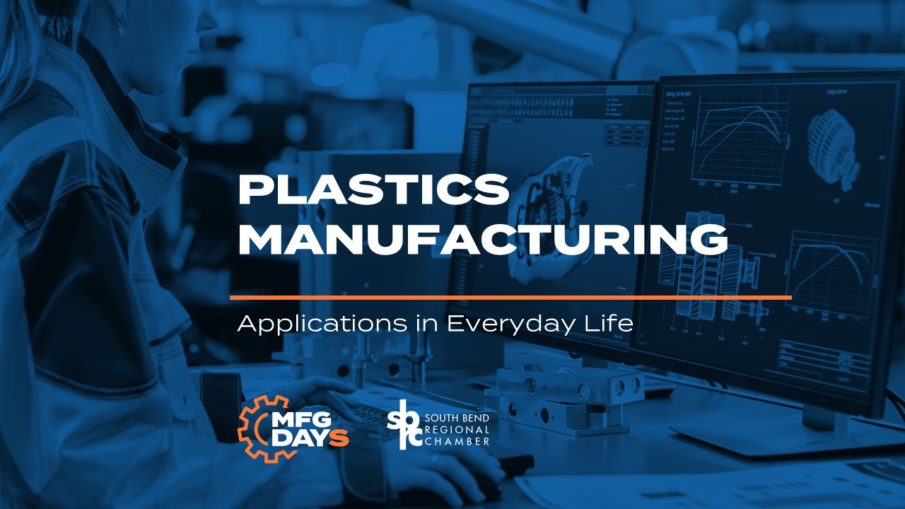

Slide 2
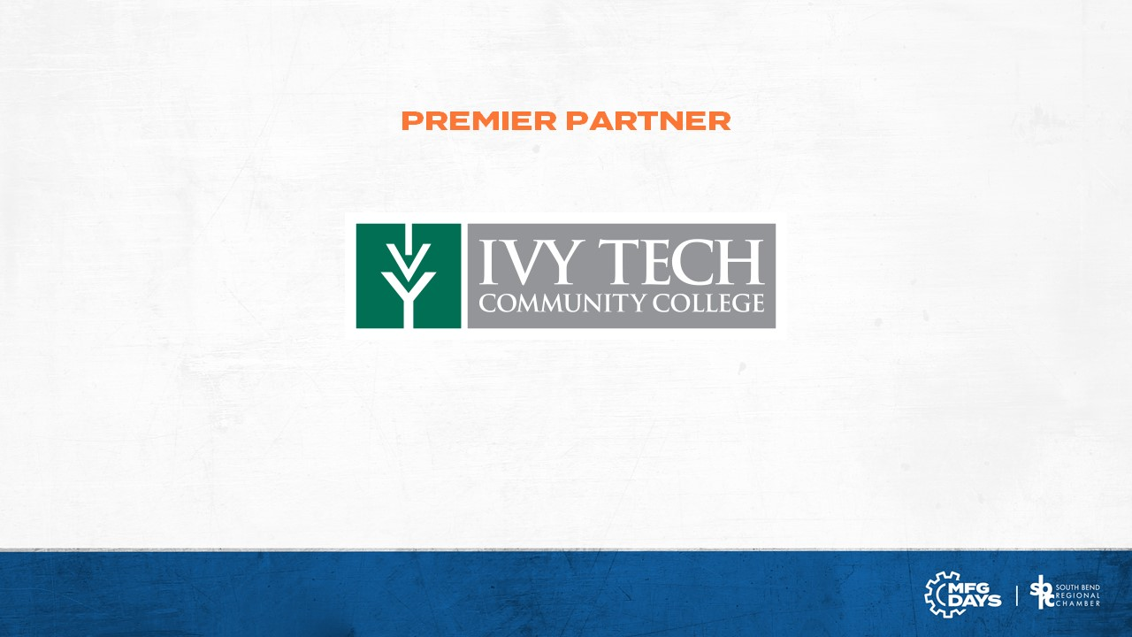

Slide 3
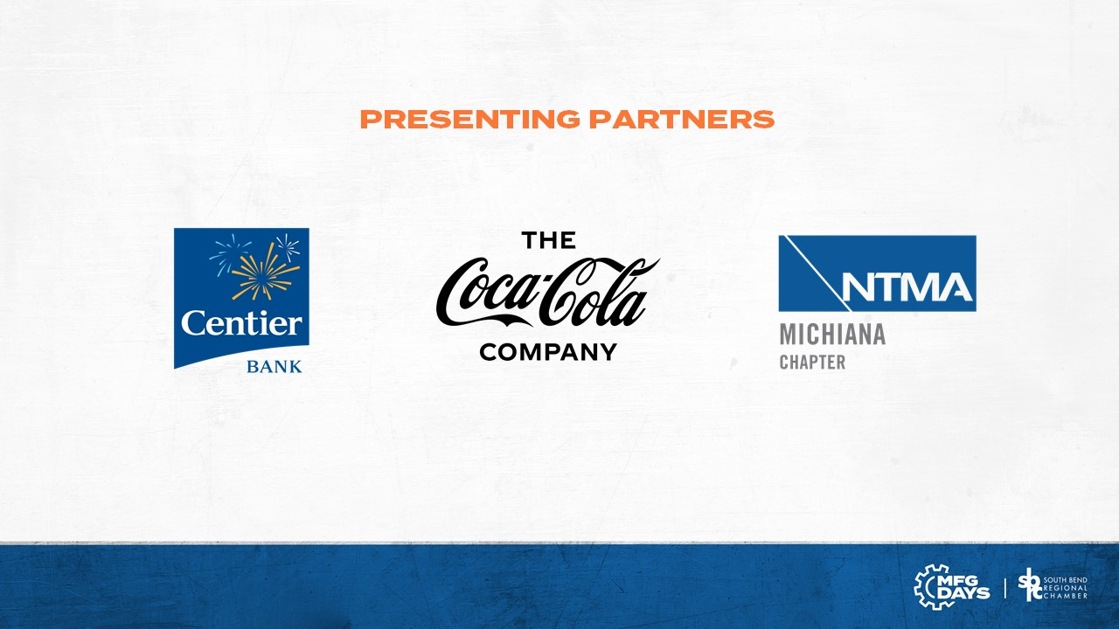

Slide 4
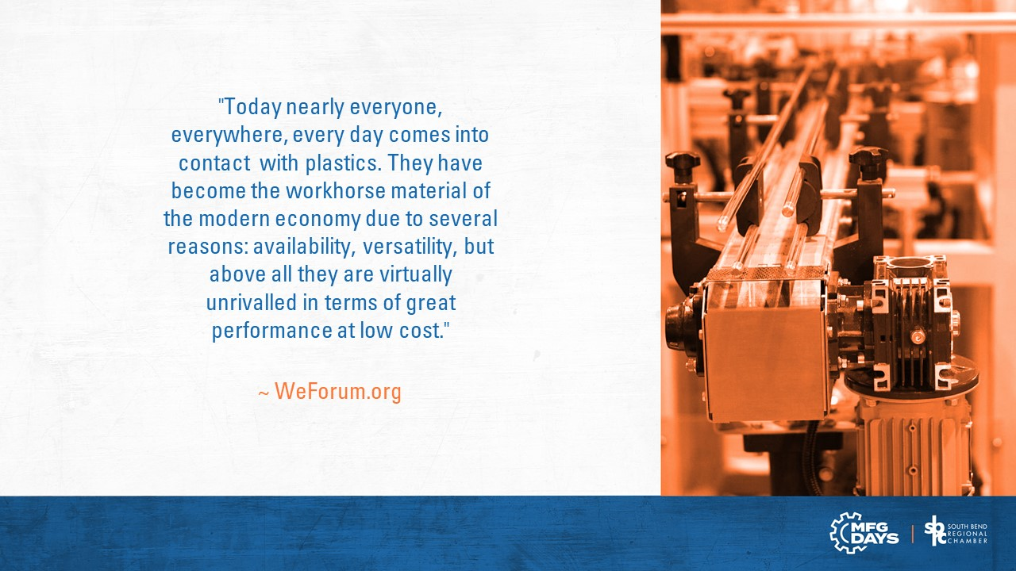

Slide 5
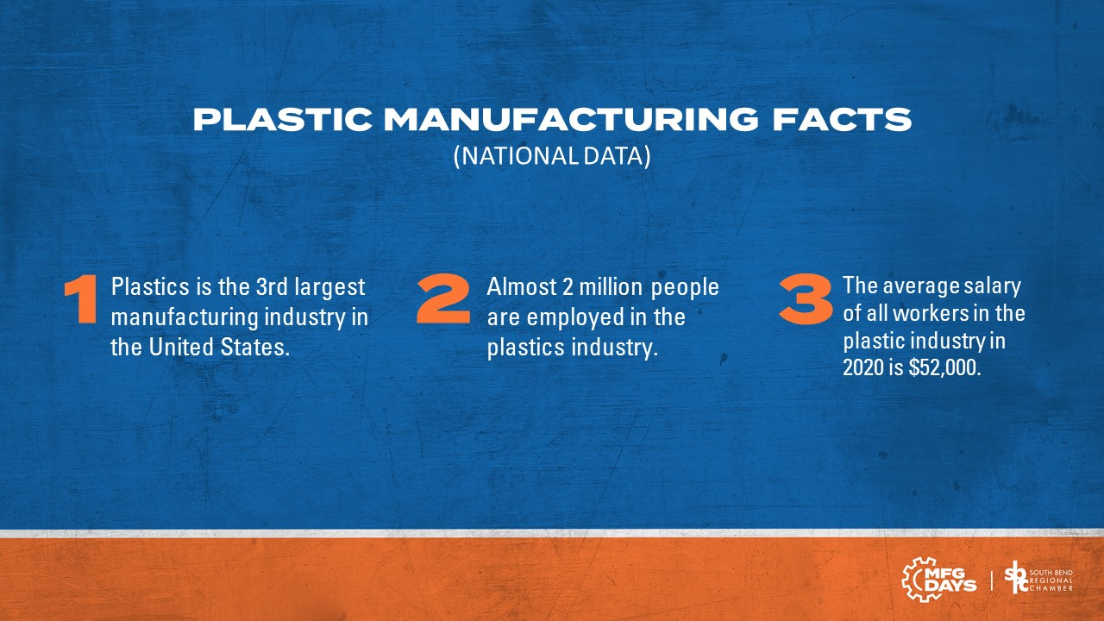

Slide 6
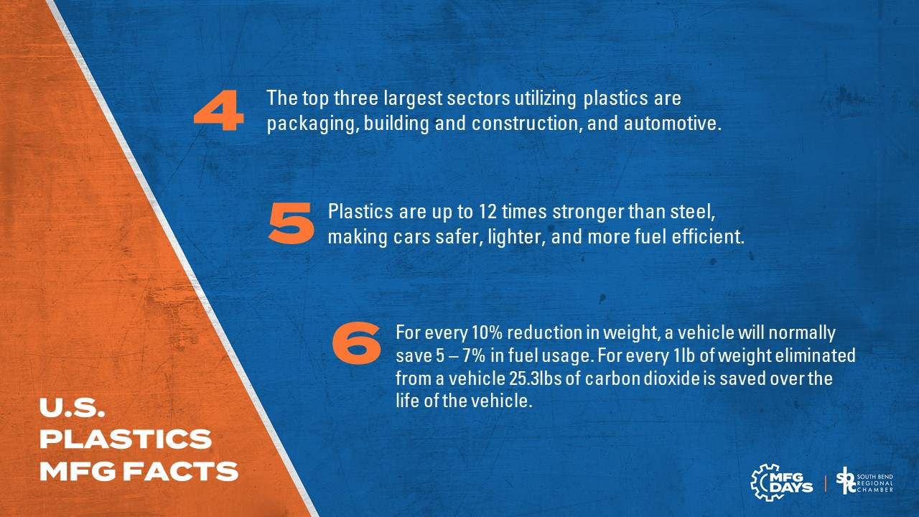

Slide 7
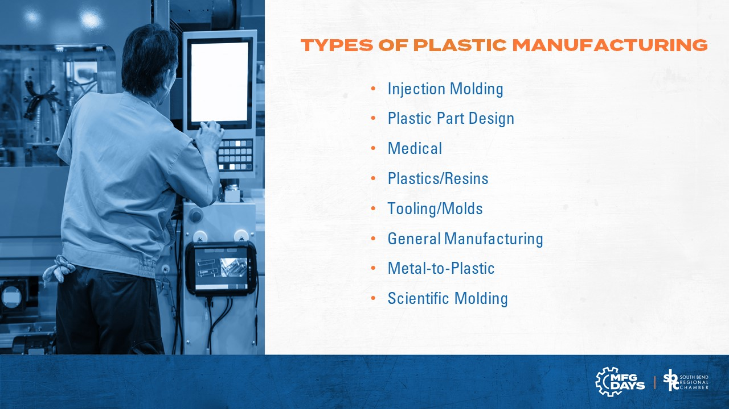

Slide 8
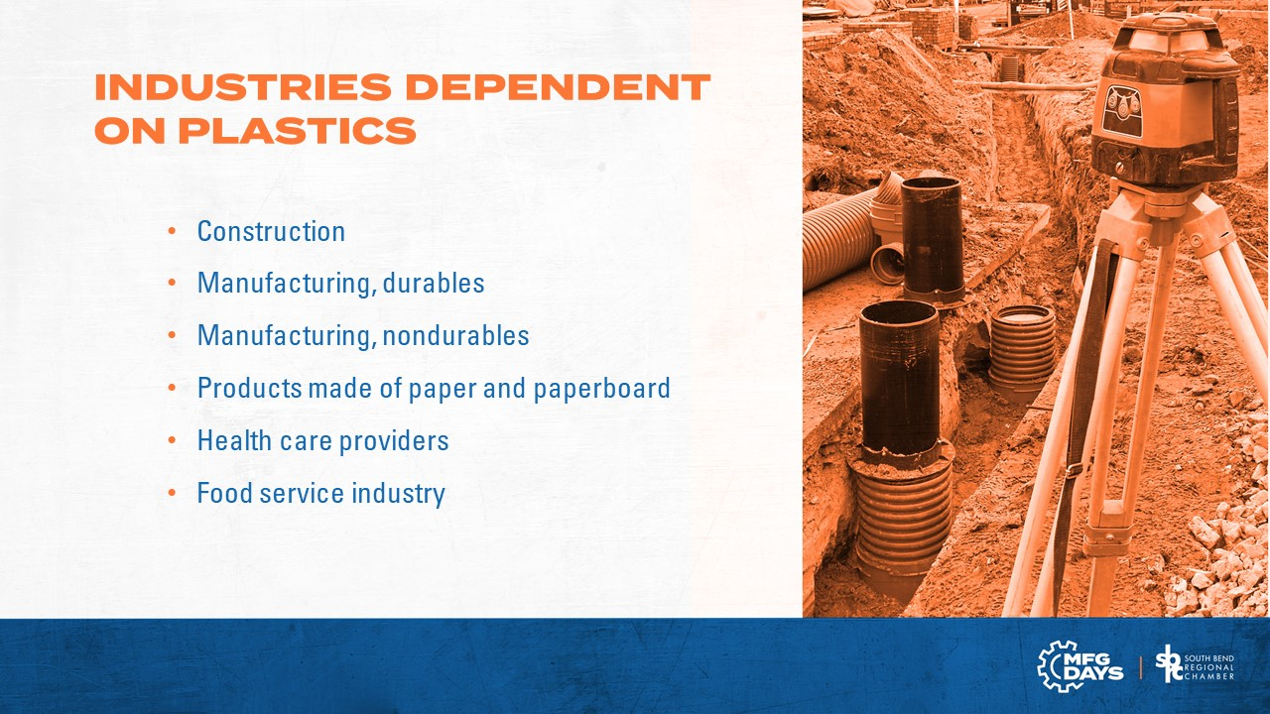

Slide 9
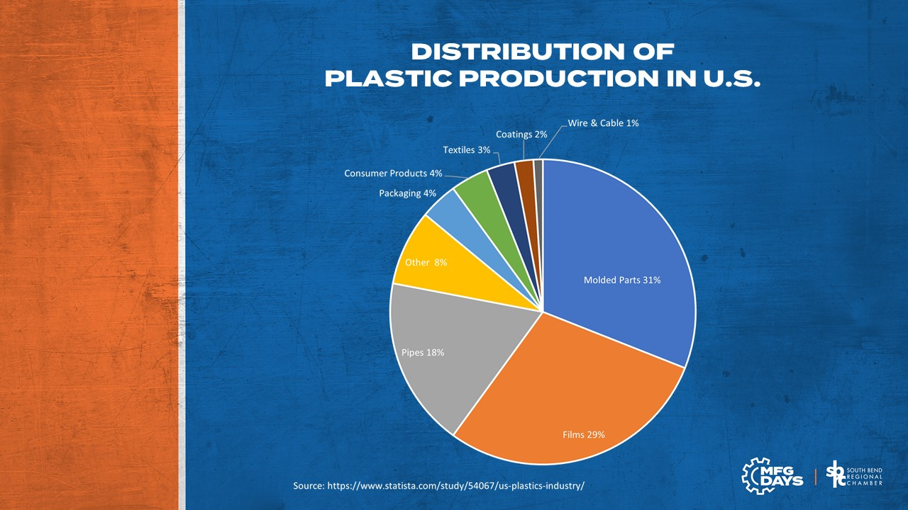

Slide 10
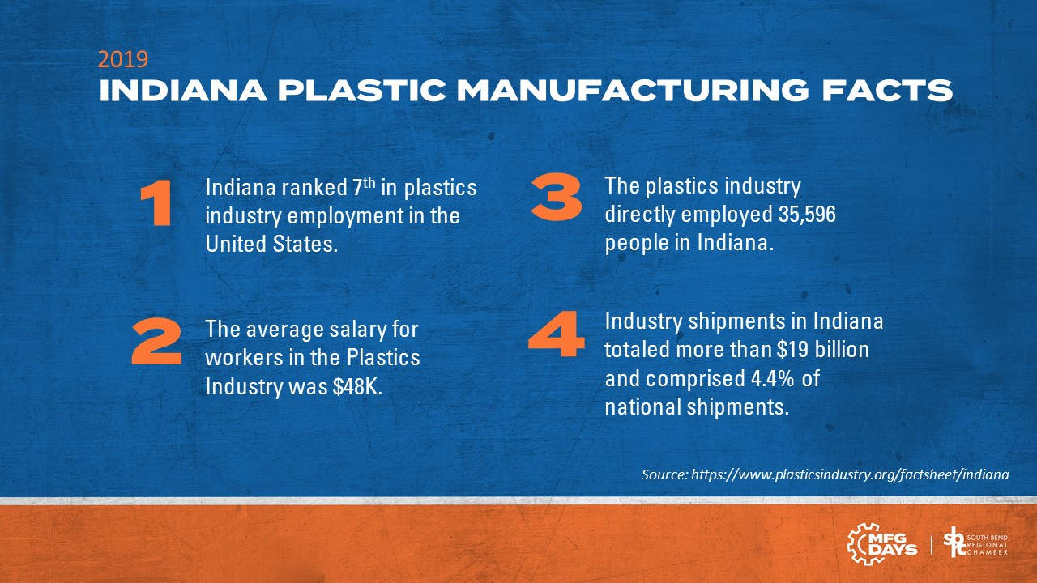

Slide 11
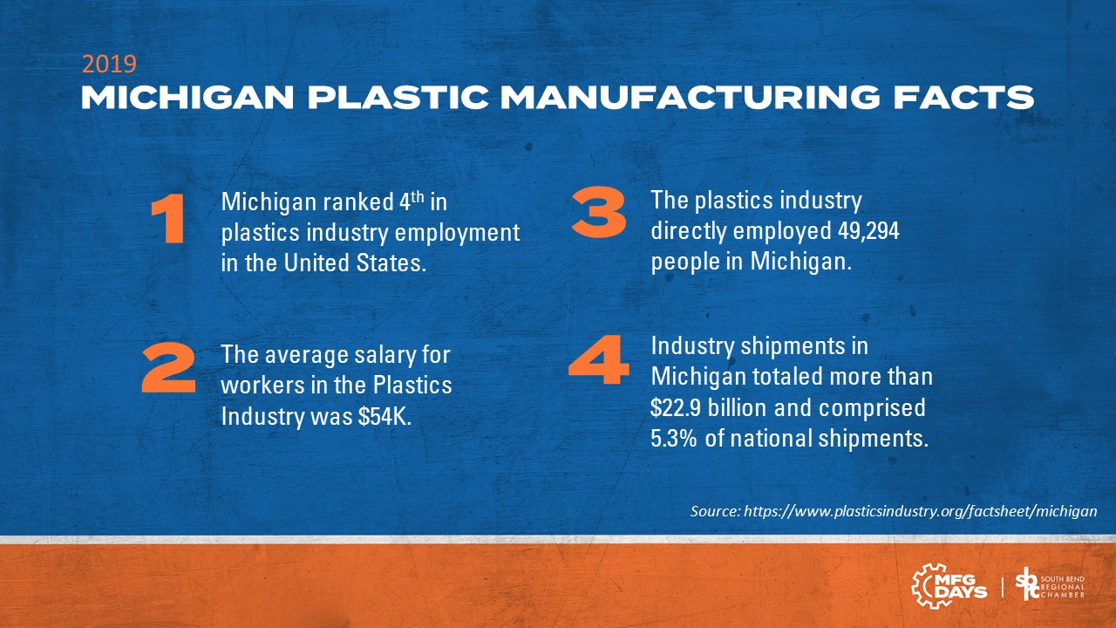

Slide 12
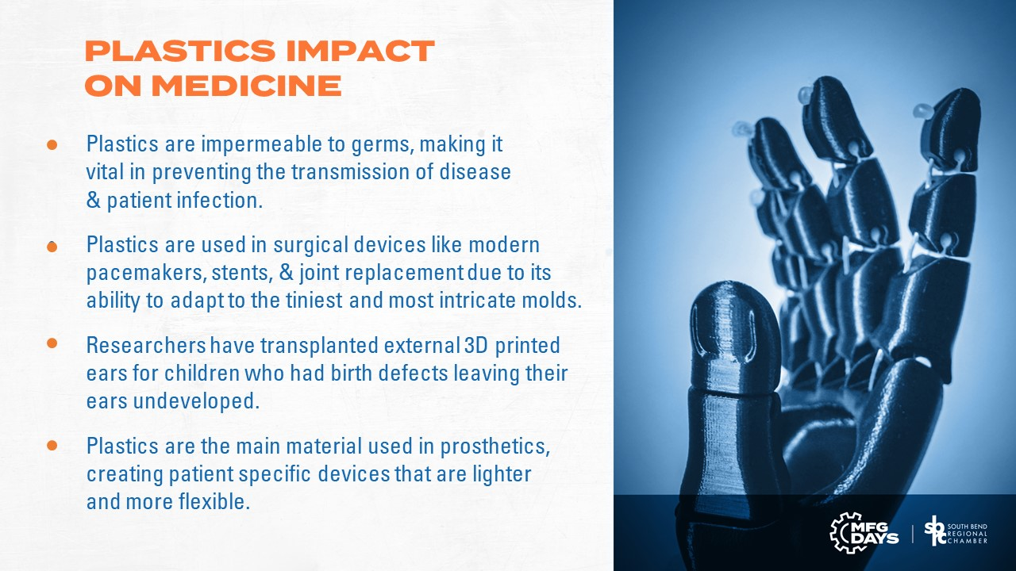

Slide 13
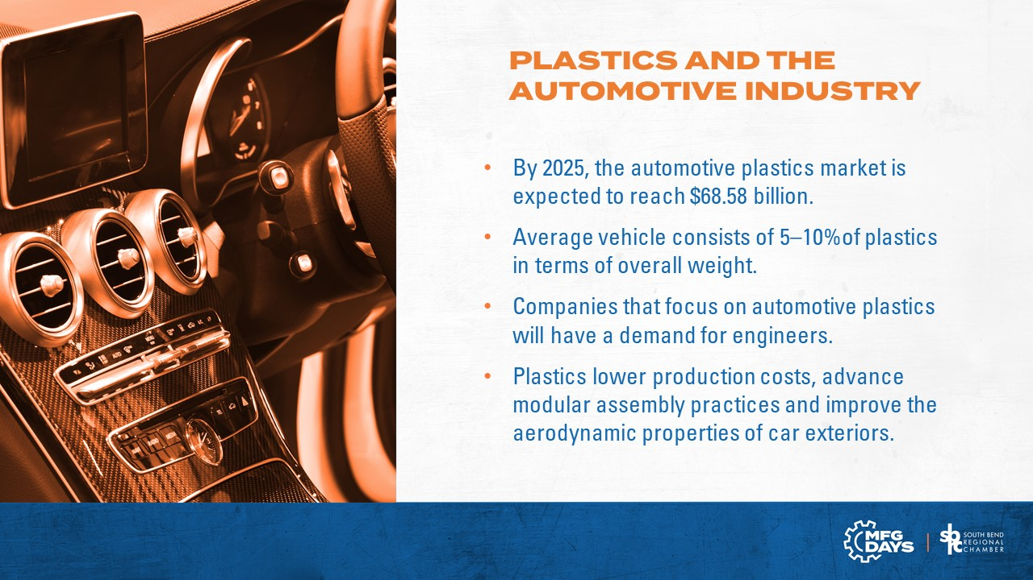

Slide 14
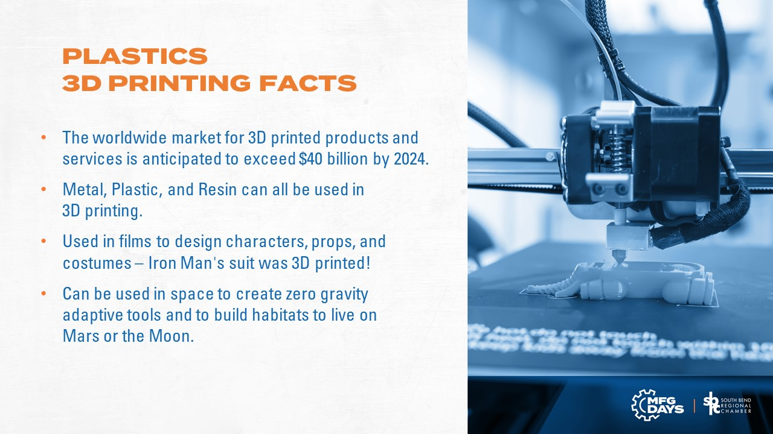

Slide 15


Slide 16
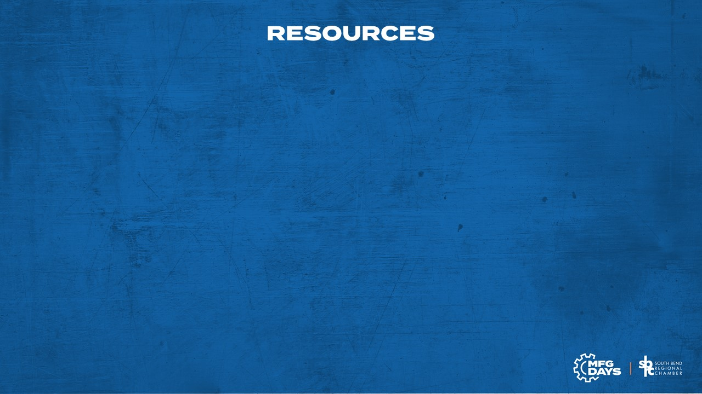
https://www.plasticsindustry.org/
https://www.plasticsindustry.org/factsheet/indiana
https://www.plasticsnews.com/perspective/2020-plastics-industry-talent-trends
https://www.plasticstoday.com/automotive-and-mobility/six-trends-impacting-global-automotive-plastics-market-new-decade
https://www.kaysun.com/blog/plastics-industry-trends-2020
https://sealectplastics.com/news/why-the-medical-industry-is-focused-on-plastic-parts/
https://datausa.io/profile/naics/plastics-product-manufacturing#:~:text=On%20average%2C%20employees%20in%20the,total%20of%20269%20Industry%20Groups.
https://www.weforum.org/agenda/2019/10/plastics-what-are-they-explainer/
https://mep.purdue.edu/news-folder/purdue-mep-s-partnership-with-city-of-south-bend-companies-results-in-new-skills-and-improved-efficiencies/
https://www.statista.com/topics/5266/plastics-industry/
https://www.mpo-mag.com/contents/view_online-exclusives/2017-10-09/5-ways-plastics-revolutionized-the-healthcare-industry/
https://www.sciencedirect.com/science/article/pii/S2352396418300161
https://xponentialworks.com/3d-printing-is-changing-lives-with-personally-printed-prosthetics/
https://agsplasticgranulation.co.uk/opinions/the-importance-of-plastic-why-plastic-is-important/

