Slide 3


Slide 4
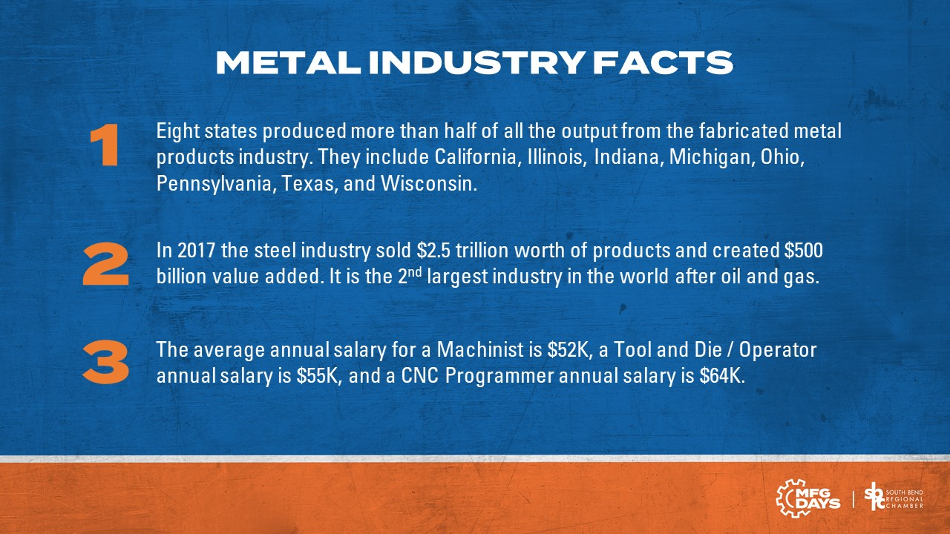

Slide 13


Slide 14

https://laserfab.net/blog/what-is-metal-fabrication/
https://www.bls.gov/iag/tgs/iag331.htm#workforce
https://agmetalminer.com/2020/02/19/this-morning-in-metals-indiana-no-1-once-again-last-year-in-steel-production/
https://www.thefabricator.com/thefabricator/article/shopmanagement/what-is-metal-fabrication-and-where-is-the-industry-headed-
https://www.goodwin.edu/enews/what-is-precision-machining/
https://www.1pds.com/fast-facts-about-the-precision-machining-industry/
https://www.kaempfandharris.com/industry-news/
https://www.zippia.com/machinist-jobs/best-states/
https://www.productionmachining.com/articles/about-the-precision-machining-industry
https://www.3dnatives.com/en/additive-manufacturing-automotive280620184/
https://www.3dnatives.com/en/metal-additive-manufacturing-technavio-report-150420205/
https://inversesolutionsinc.com/how-precision-machining-has-an-effect-on-medical-devices/
https://www.bls.gov/ooh/production/machinists-and-tool-and-die-makers.htm

