Slide 1


Slide 2


Slide 3


Slide 4
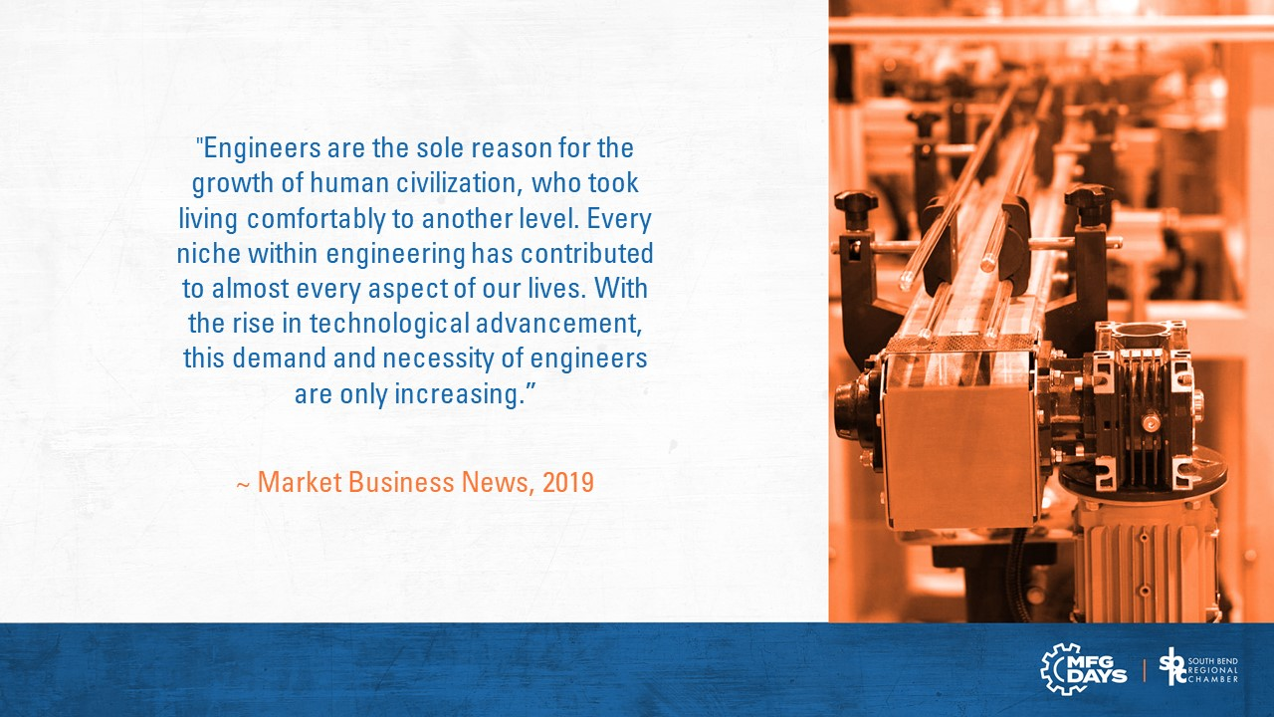

Slide 5
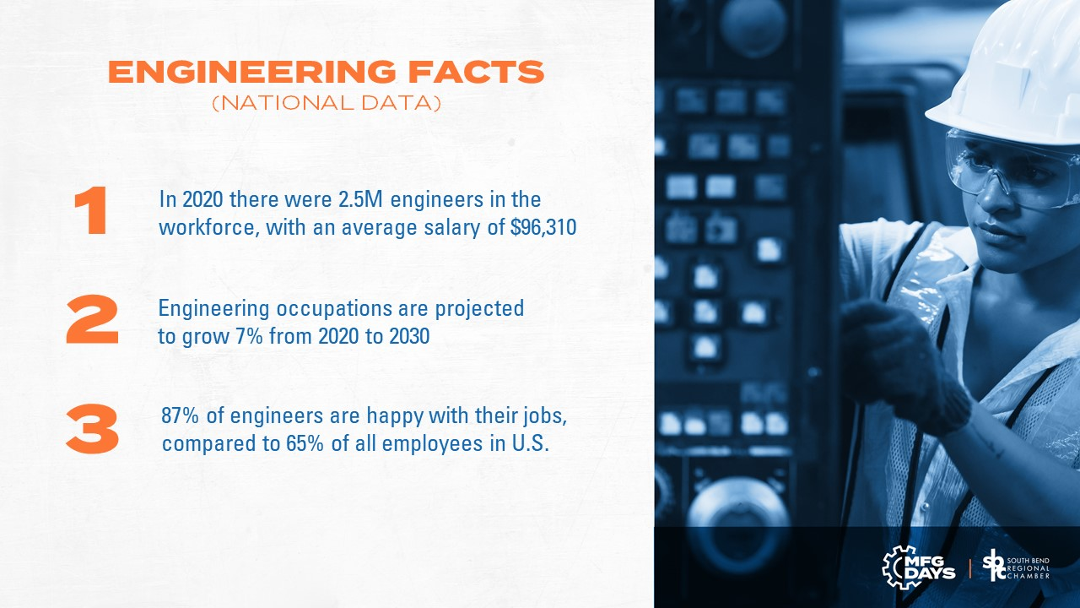

Slide 6
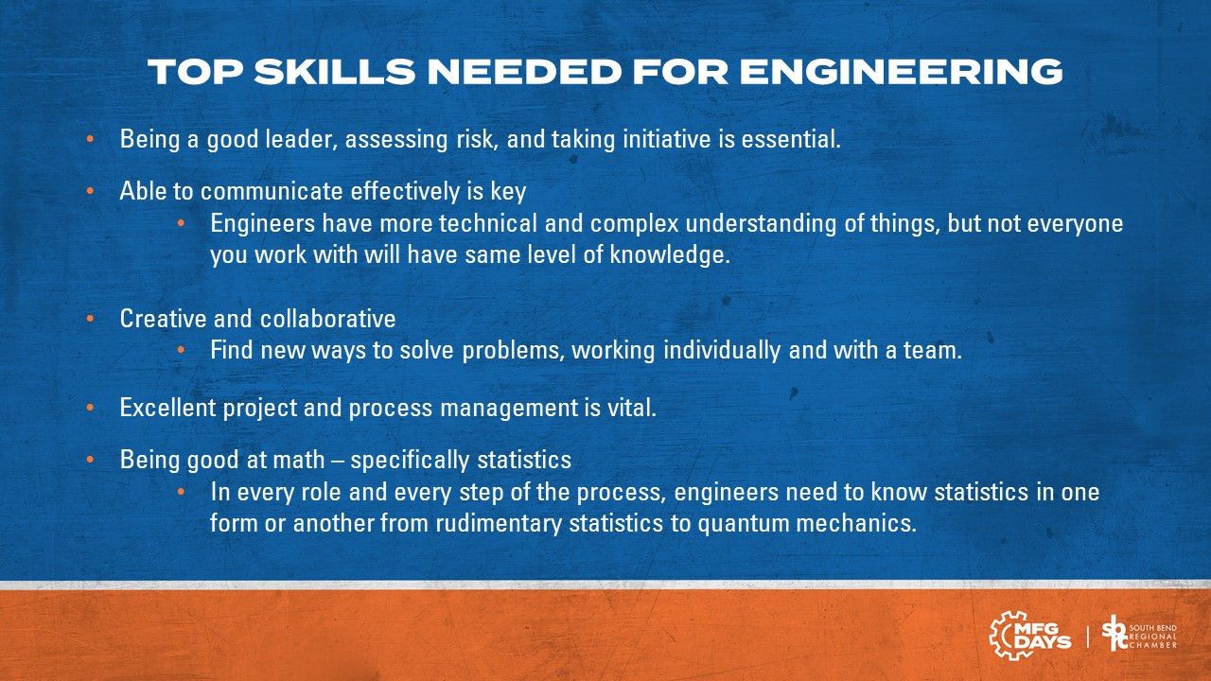

Slide 7
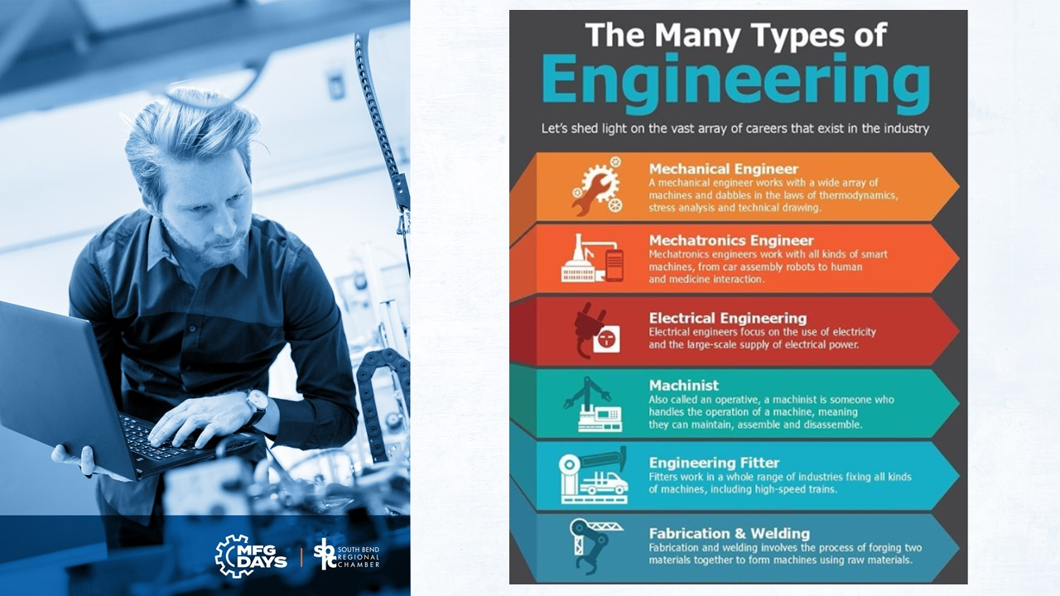

Slide 8
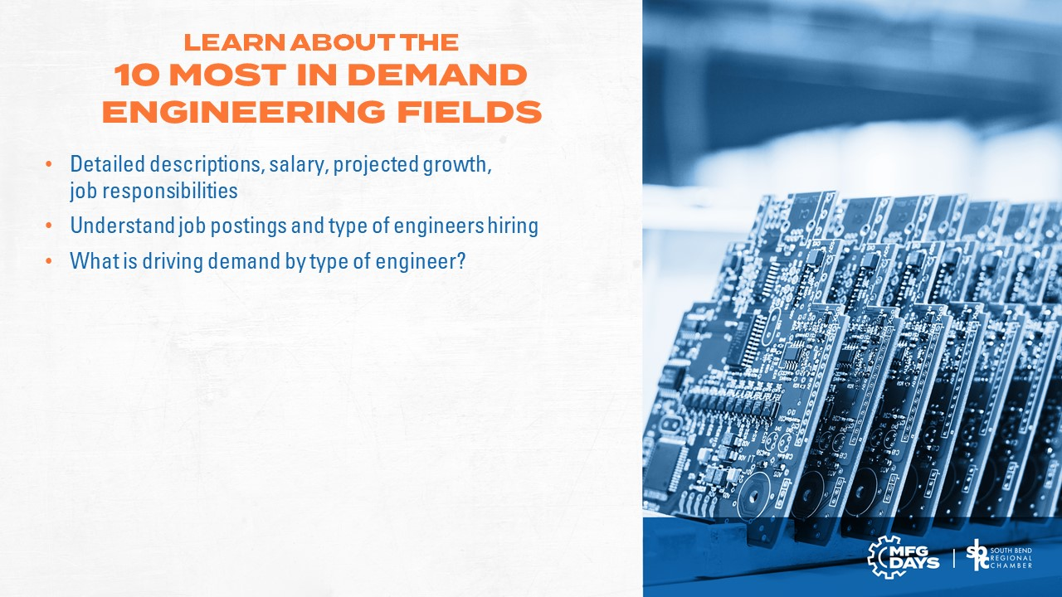
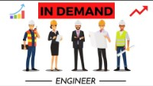

Slide 9
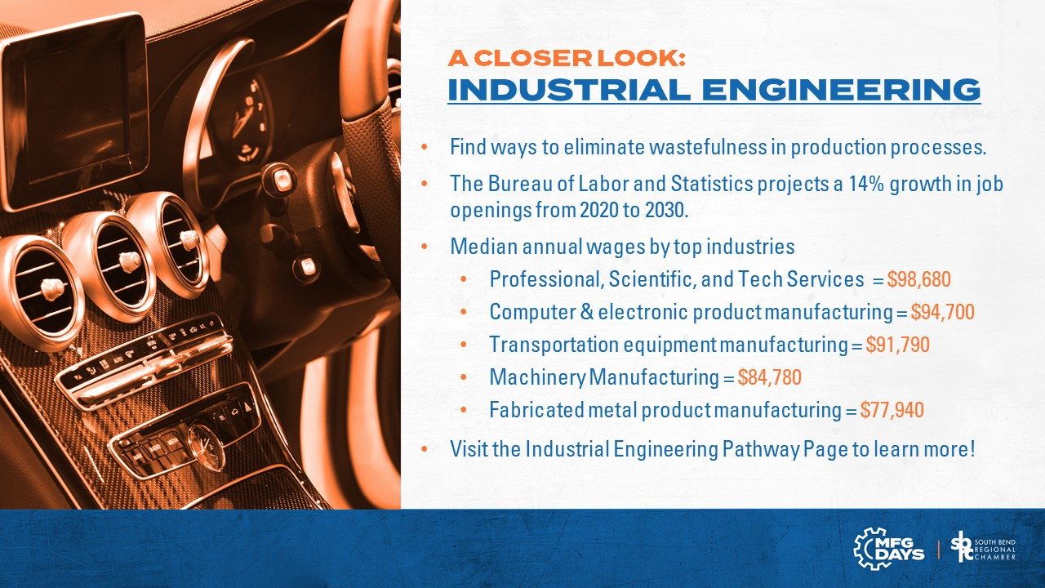

Slide 10
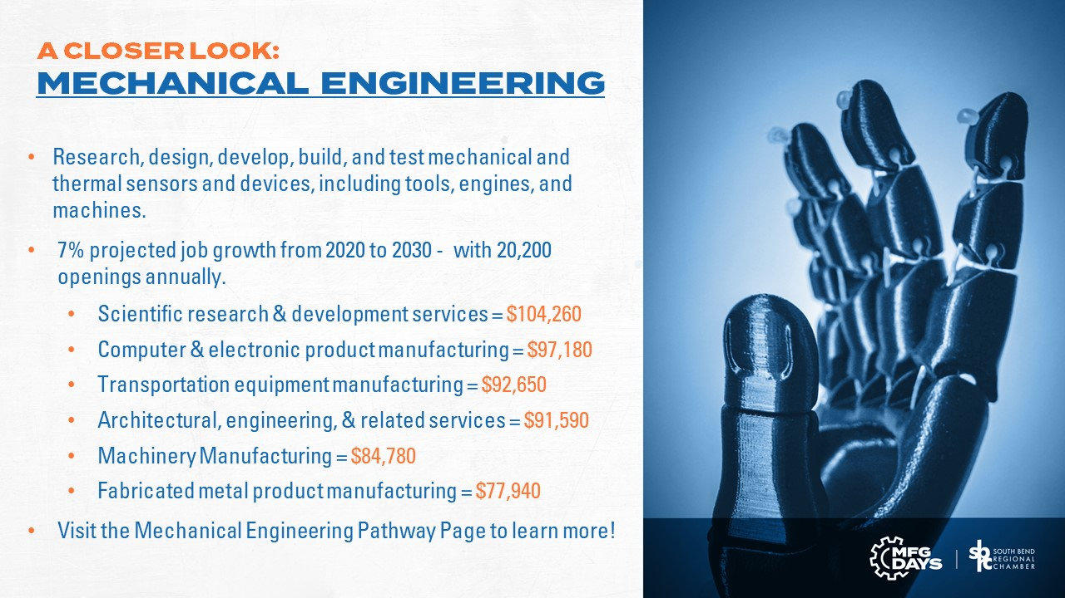

Slide 11


Slide 12
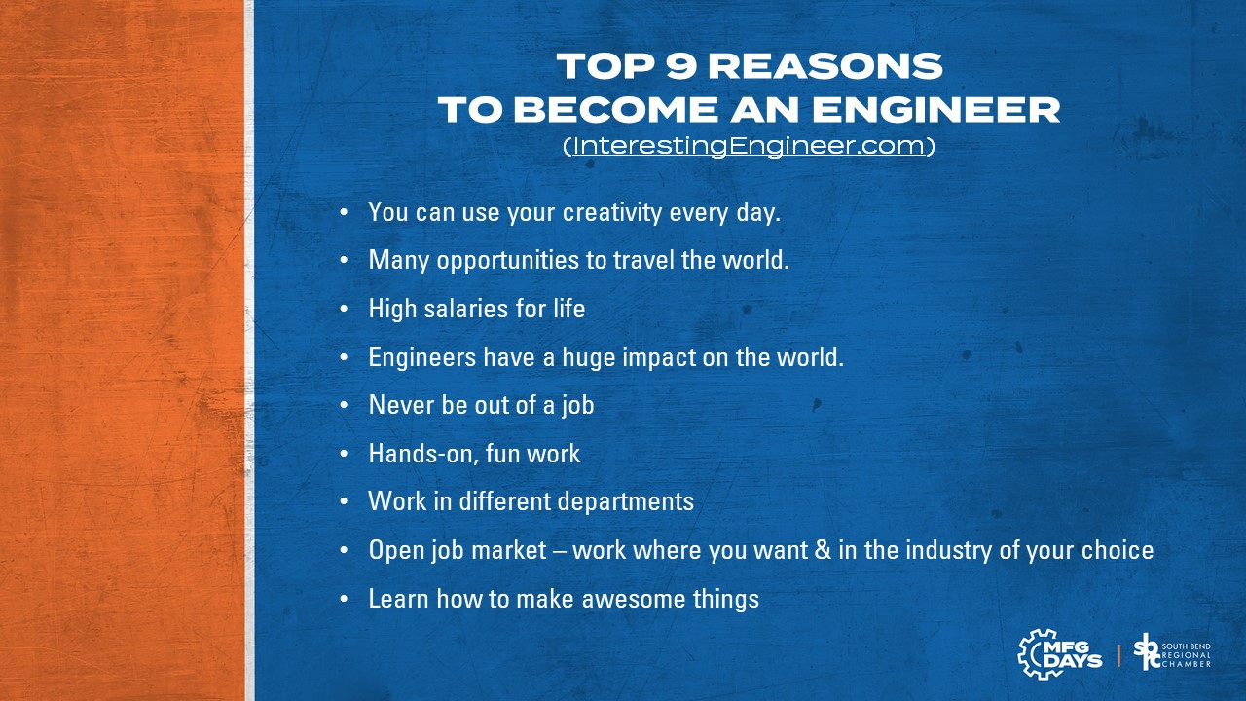

Slide 13



Slide 14


Slide 15

https://www.machinedesign.com/learning-resources/article/21837044/is-the-engineering-profession-still-a-good-job
https://whattobecome.com/blog/job-satisfaction-statistics/
https://marketbusinessnews.com/world-needs-more-engineers/221306/
https://www.topuniversities.com/student-info/careers-advice/why-demand-engineering-graduates-rise
https://www.bls.gov/oes/current/oes170000.htm
https://www.bls.gov/ooh/architecture-and-engineering/home.htm
https://www.bls.gov/ooh/architecture-and-engineering/industrial-engineers.htm
https://www.bls.gov/ooh/architecture-and-engineering/industrial-engineers.htm#tab-5
https://www.onlineengineeringprograms.com/faq/fastest-growing-engineering-fields
https://interestingengineering.com/top-9-reasons-to-become-an-engineer

