Slide 1
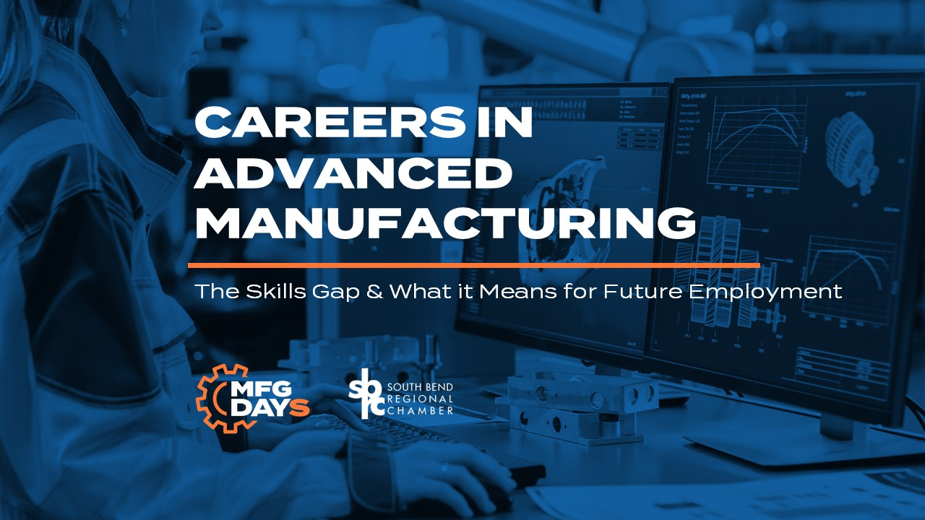

Slide 2


Slide 3


Slide 4
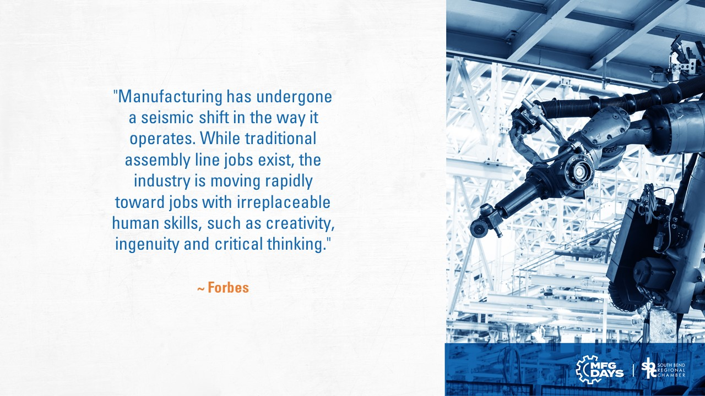

Slide 5
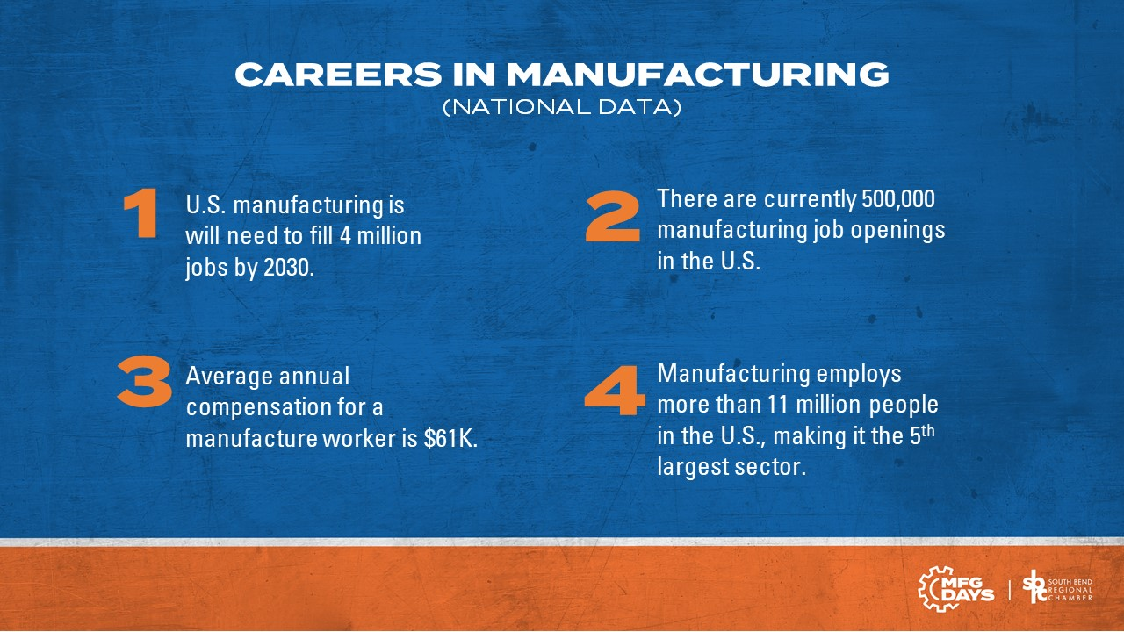

Slide 6
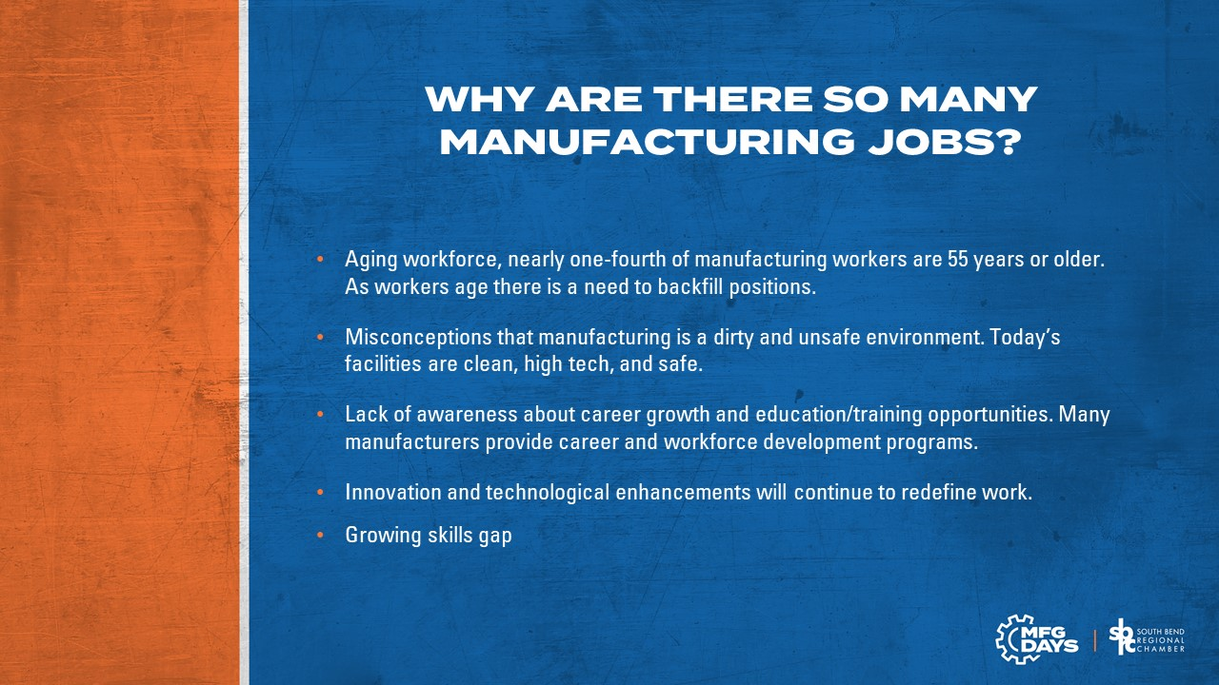

Slide 7
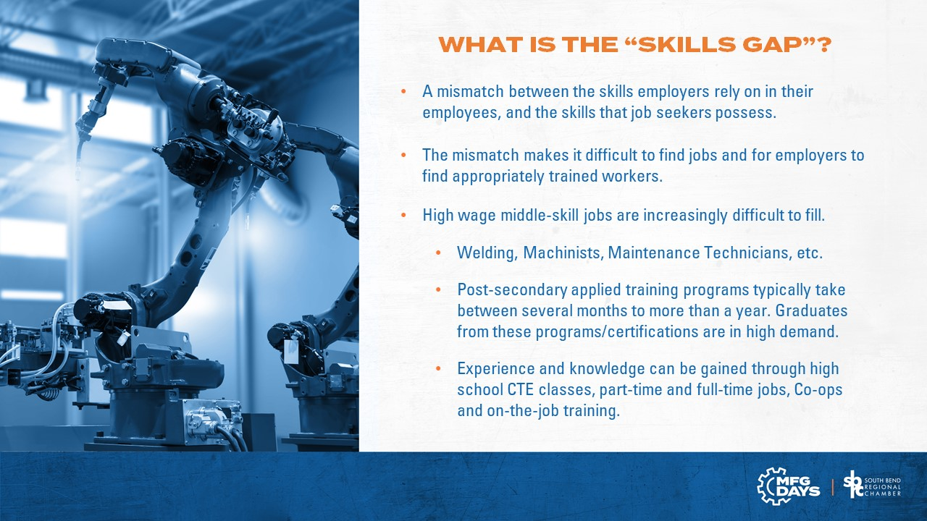

Slide 8
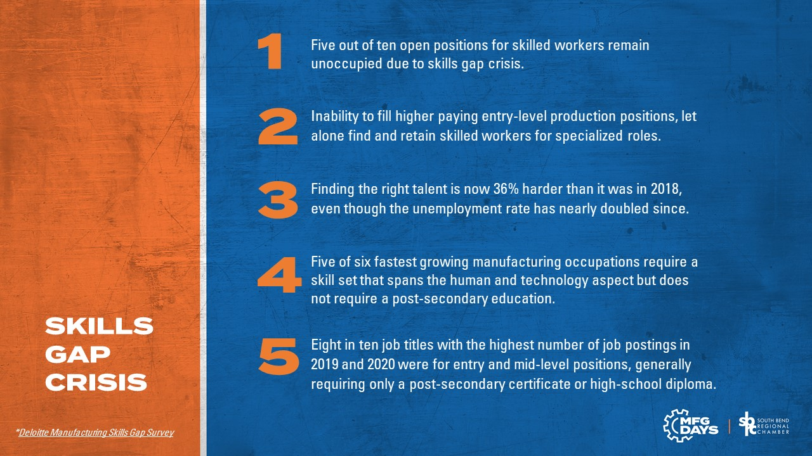

Slide 9
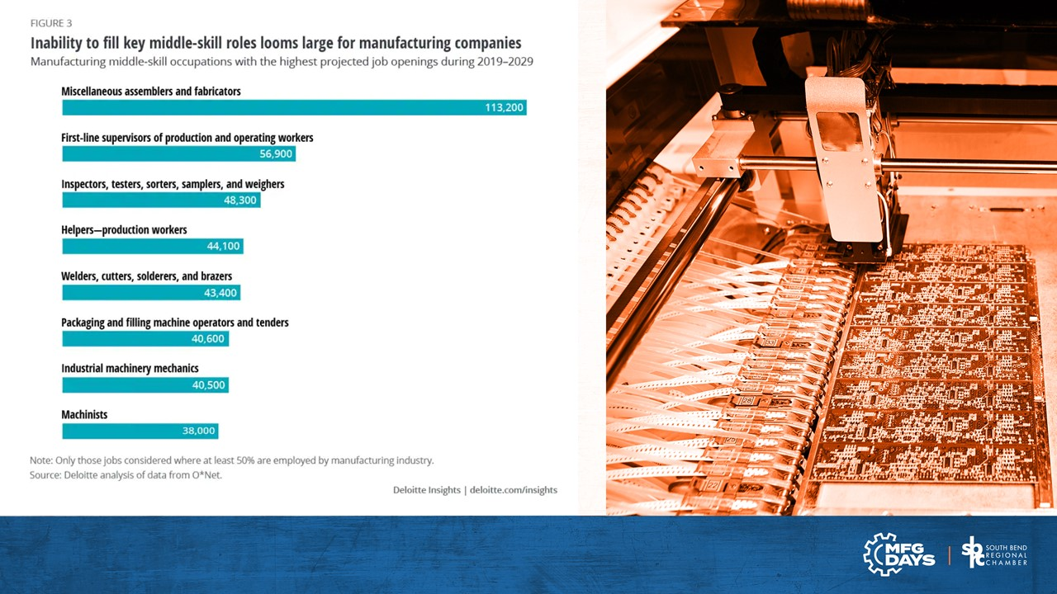

Slide 10
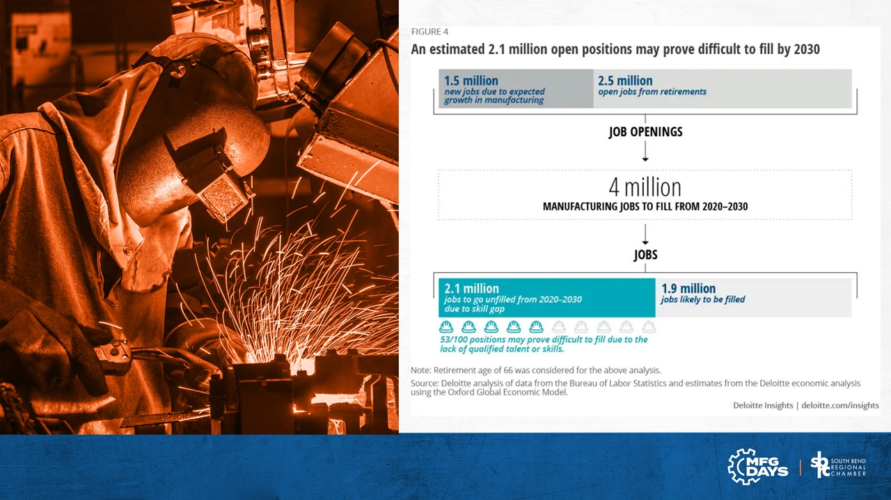

Slide 11
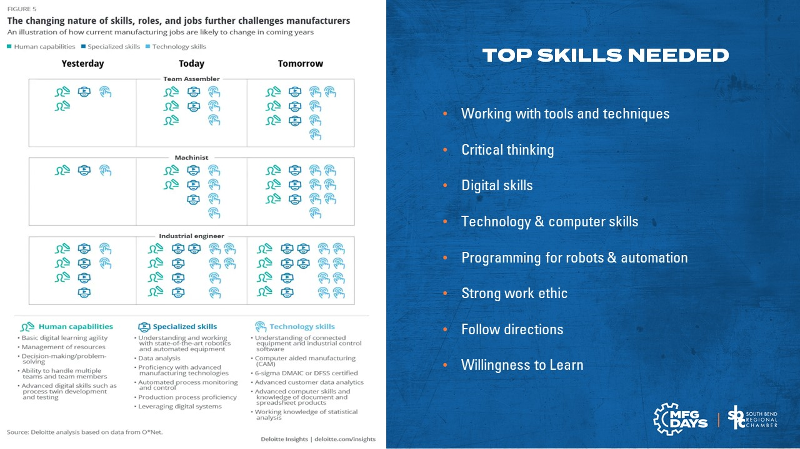

Slide 12
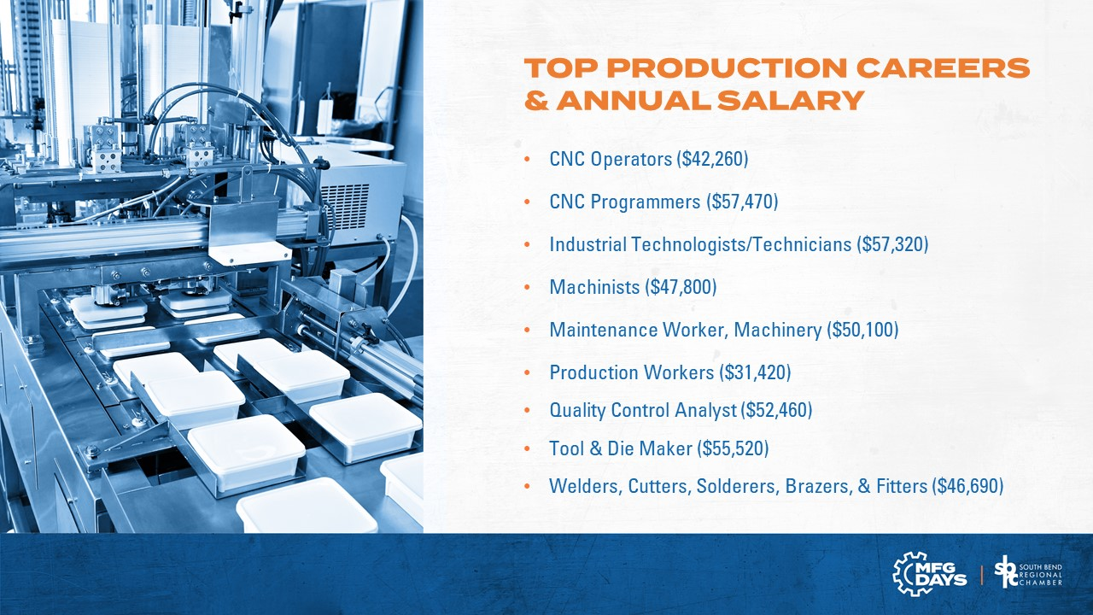

Slide 13
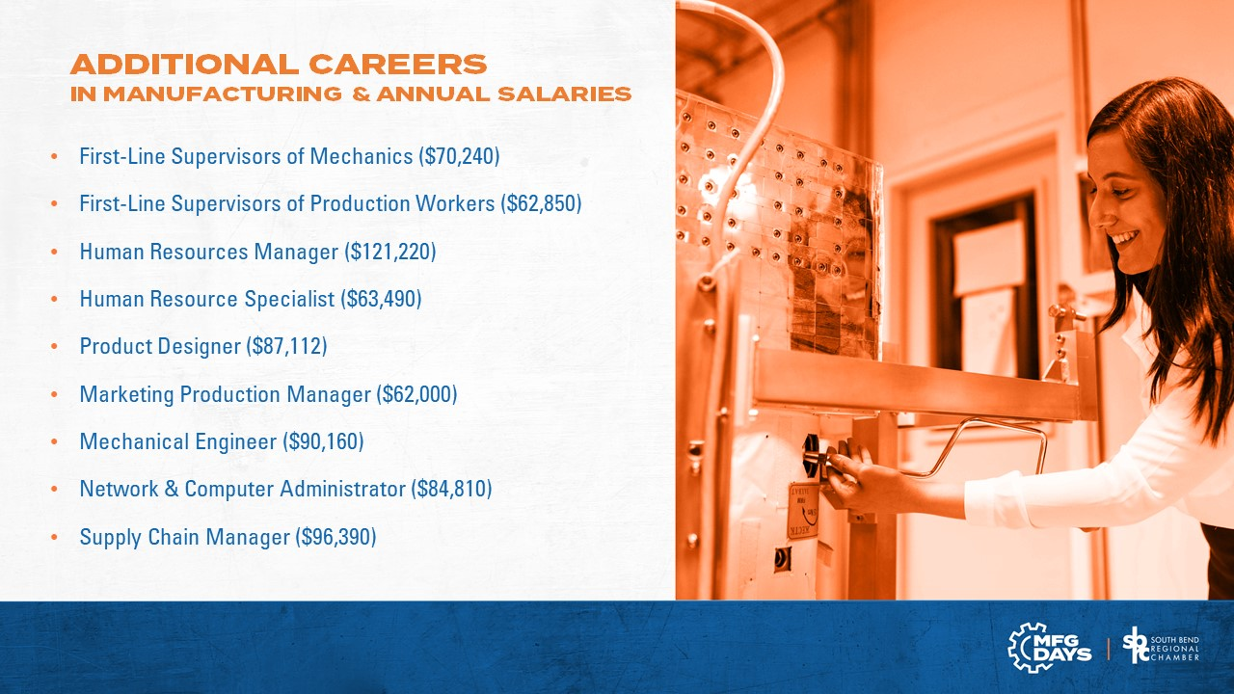

Slide 14
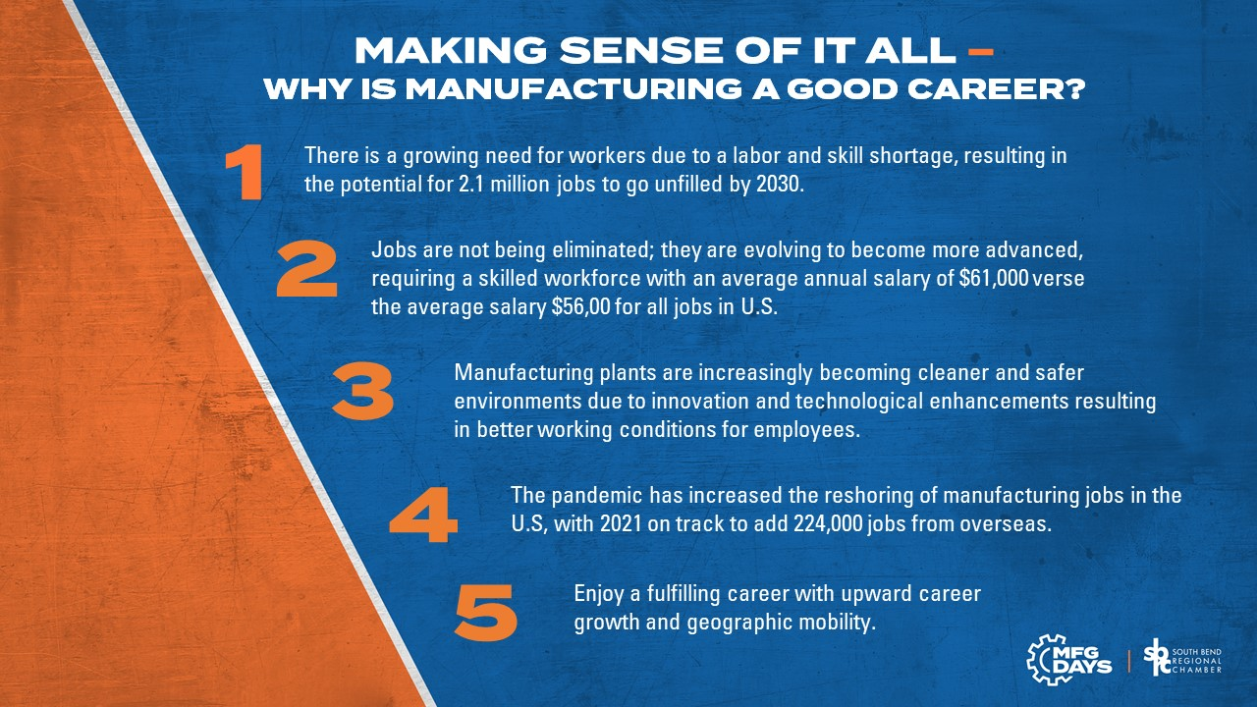

Slide 15


Slide 16

www.asme.org/topics-resources/content/state-of-american-manufacturing-2019
www.nam.org/facts-about-manufacturing/
www.forbes.com/sites/realspin/2017/03/08/future-proofing-manufacturing-jobs/#647bf9771375
https://www2.deloitte.com/us/en/pages/manufacturing/articles/future-of-manufacturing-skills-gap-study.html
https://www2.deloitte.com/us/en/insights/industry/manufacturing/manufacturing-industry-diversity.html
https://www.bcg.com/press/28september2015-how-will-technology-transform-industrial-workforce
https://www.zippia.com/production-and-manufacturing-industry/
https://www.census.gov/library/visualizations/2021/comm/the-big-paycheck.html

